Slide 1
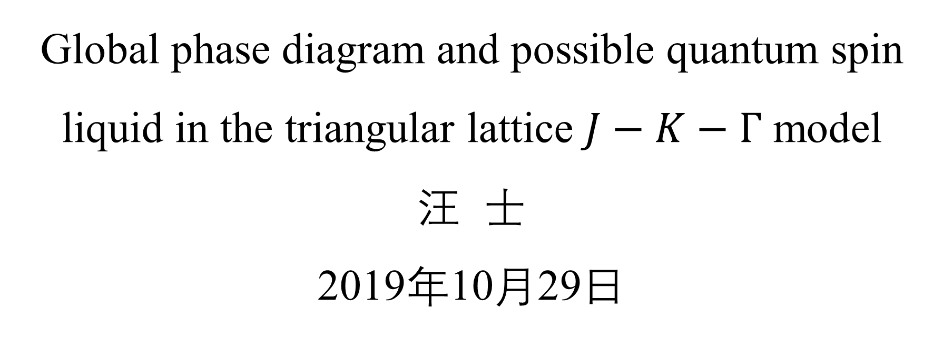
Global phase diagram and possible quantum spin liquid in the triangular lattice $J−K−Γ$ model
汪 士
2019年10月29日
Notes:
各位老师同学大家晚上好.今天在这里给大家介绍一下我最近做的一个工作,关于三角晶格上J-K-Gamma模型的全局相图以及可能的自旋液体相.

Slide 2
Outline
Background and motivation
Global phase diagram and analysis
Summary and future work
Notes:
今天报告主要分为以下三个部分.首先是关于相关研究背景的一个简要介绍,接下来是关于我们所作工作的一个介绍,最后是对于前期工作的一个总结.

Slide 3
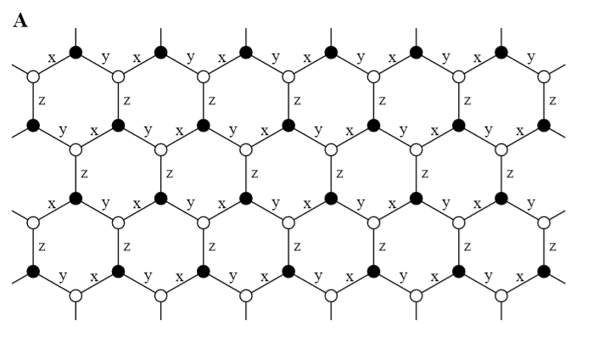
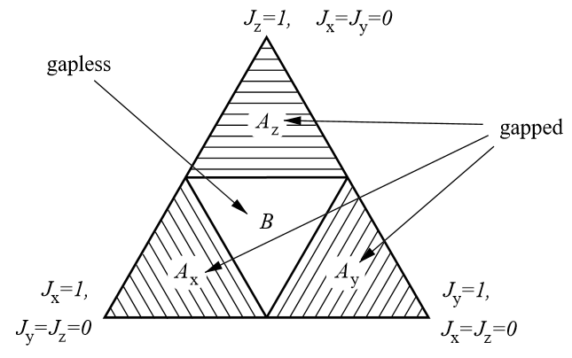
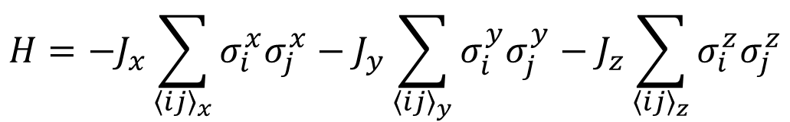
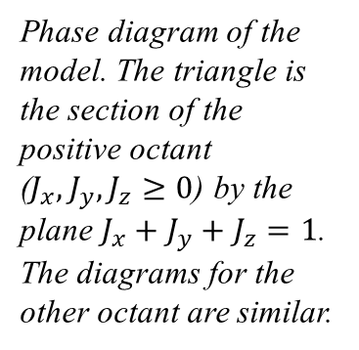
Kitaev model
$$H=−J_{x}\sum_{{\left\langle ij\right\rangle }_{x}}{σ_{i}^{x}σ_{j}^{x}}−J_{y}\sum_{{\left\langle ij\right\rangle }_{y}}{σ_{i}^{y}σ_{j}^{y}}−J_{z}\sum_{{\left\langle ij\right\rangle }_{z}}{σ_{i}^{z}σ_{j}^{z}}$$
Exactly solved 2D quantum spin model
The gapped phase carries excitations that are Abelian anyons
For the gapless phase, the excitations are non-Abelian anyons
Anyons might be used in fault tolerant quantum computations
Phase diagram of the model. The triangle is the section of the positive octant ($J_{x},J_{y},J_{z}≥0$) by the plane $J_{x}+J_{y}+J_{z}=1$. The diagrams for the other octant are similar.
Alexei Kitaev, Annals of Physics 321, 2 (2006)
Notes:
我们的故事得从Kitaev模型讲起. Kitaev模型是一个定义在在蜂窝格子上的自旋模型.如图所示, 蜂窝格子上的每个格点有三个最近邻,三个最近邻之间的自旋相互作用分别取x, y, z三种Ising型相互作用, 并且不同类型相互作用的系数是不同的,分别取为Jx, Jy, Jz. 这样一个模型是严格可解的,Kitaev在他的文章中给出了系统基态相图. 其中在相图的中间部分, 是一个无能隙的相, 系统的激发是非阿贝尔的任意子激发, 而在图中的橙色部分是无能隙的相,系统激发是阿贝尔的任意子激发. 至于从实用的角度来说,任意子激发是有可能被用来实现量子计算的.

Slide 4
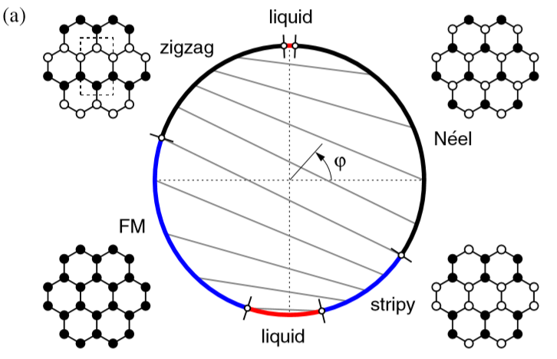
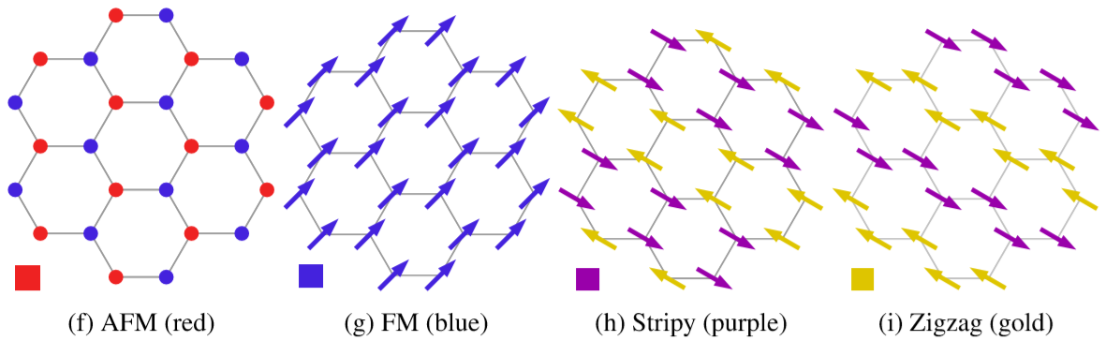
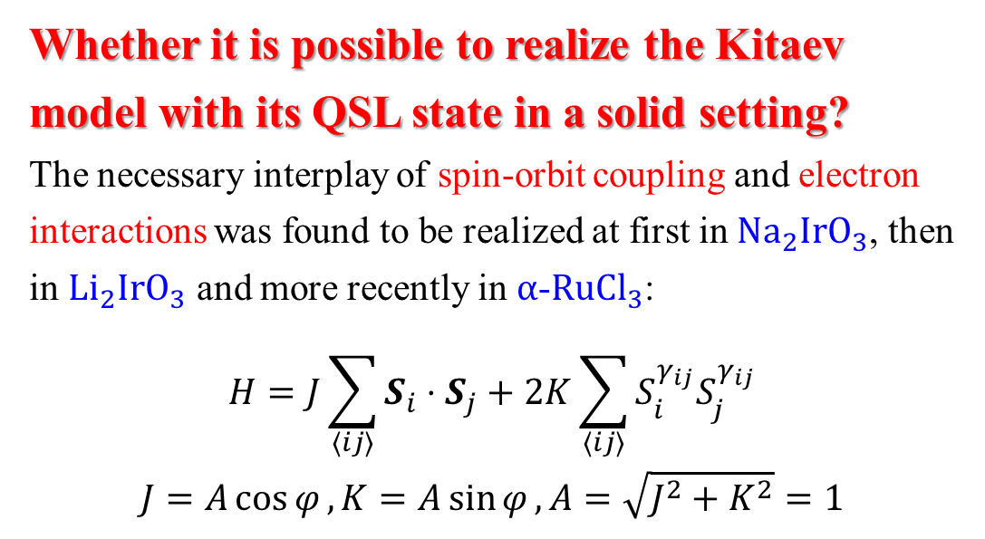
Kitaev Heisenberg model
Whether it is possible to realize the Kitaev model with its QSL state in a solid setting?
The necessary interplay of spin-orbit coupling and electron interactions was found to be realized at first in $Na_{2}IrO_{3}$, then in $Li_{2}IrO_{3}$ and more recently in $α$-$RuCl_{3}$:
$$H=J\sum_{⟨ij⟩}{S_{i}⋅S_{j}}+2K\sum_{⟨ij⟩}{S_{i}^{γ_{ij}}S_{j}^{γ_{ij}}}$$
$$J=A\cos{φ},K=A\sin{φ}, A=\sqrt{J^{2}+K^{2}}=1$$
G. Khaliullin, Progress of Theoretical Physics Supplement, 160:155-202, 2005
G. Jackeli and G. Khaliullin, Phys. Rev. Lett. 102, 017205(2009)
J. Chaloupka, G. Jackeli and G. Khaliullin, Phys. Rev. Lett. 105, 027204(2010)
J. Chaloupka, G. Jackeli and G. Khaliullin, Phys. Rev. Lett. 110, 097204(2013)
Notes:
正是由于Kitaev模型在理论和实际应用中的价值,所以自从Kitaev模型被提出以来人们就一直在探索如何在实际材料中来实现这个模型. 最先被提出来可能实现Kitaev型相互作用的是Na2IrO3, 然后是Li2IrO3以及最近研究的比较多的alpha-RuCl3. 之所以这些材料被认为可能实现Kitaev型相互作用因为这些材料中自旋轨道耦合作用比较强. Khaliullin等人利用二阶微扰理论, 给出了Kitaev型相互作用的起源,并且给出了这样一个模型来描述Na2IrO3等材料, 一般把这个模型称为KH 模型, 模型的第一项是各项同性的Heisenberg模型,第二项就是Kitaev项.对于KH模型,Khaliullin等人利用四子格变换以及严格对角化方法给出了系统的基态相图.相图一共存在5个相,分别是铁磁相,zigzag项,条纹项, Neel相,以及自旋液体相. 然而,一方面从KH模型出发进行的理论计算结果与实验数据不符,另一方面

Slide 5
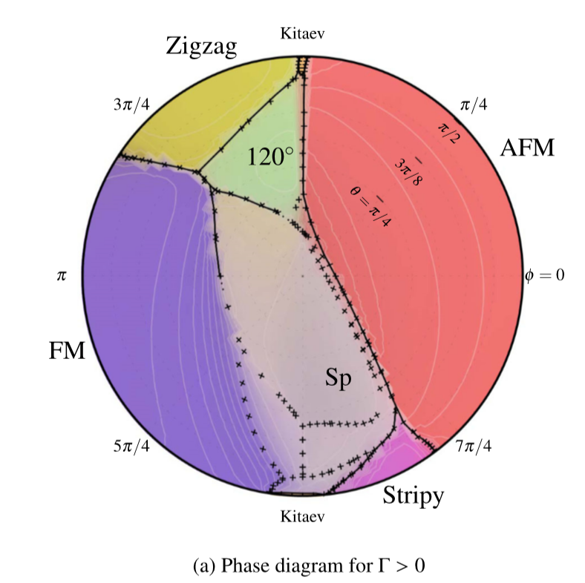
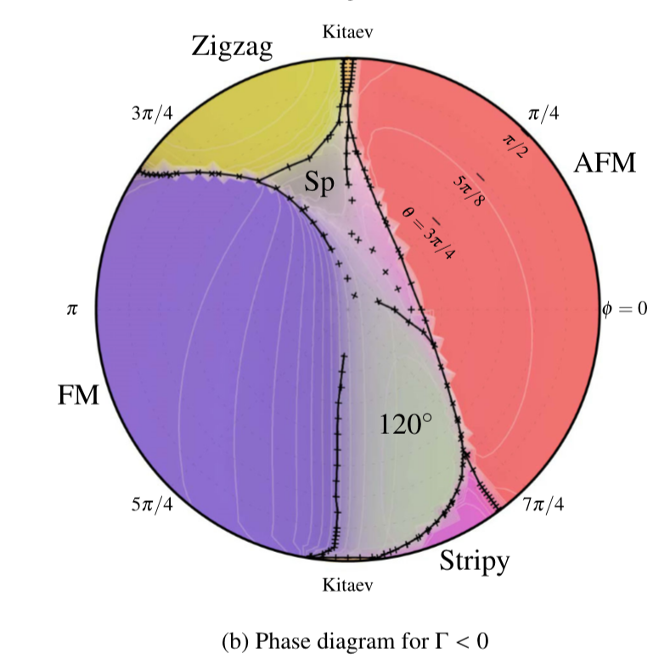
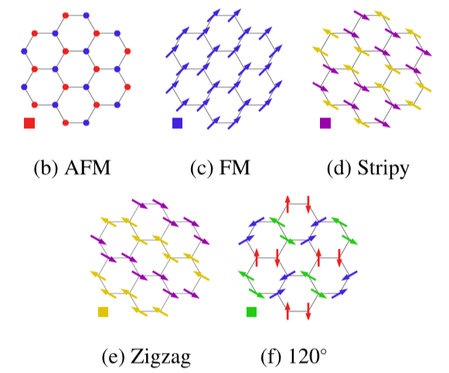
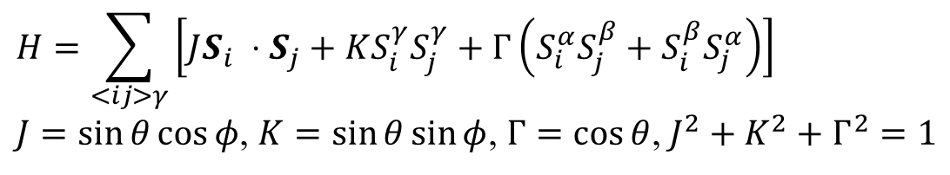
$J−K−Γ$ model
$$H=\sum_{<ij>γ}{\left[JS_{i} ⋅S_{j}+KS_{i}^{γ}S_{j}^{γ}+Γ\left(S_{i}^{α}S_{j}^{β}+S_{i}^{β}S_{j}^{α}\right)\right]}$$
$J=\sin{θ}\cos{φ}$, $K=\sin{θ}\sin{φ}$, $Γ=\cos{θ}$, $J^{2}+K^{2}+Γ^{2}=1$
Jeffrey G. Rau, Eric Kin-Ho Lee, and Hae-Young Kee, Phys. Rev. Lett. 112, 077204(2014)
Wei Wang, Zhao-Yang Dong, Shun-Li Yu, and Jian-Xin Li Phys. Rev. B 96, 115103(2017)

Slide 6
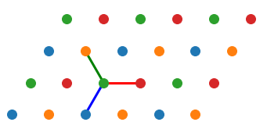
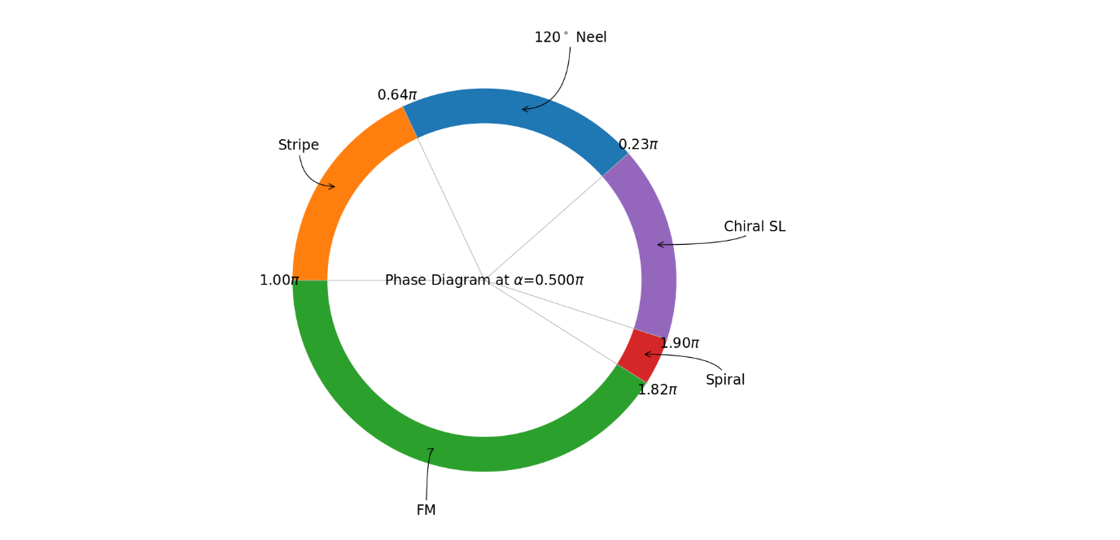
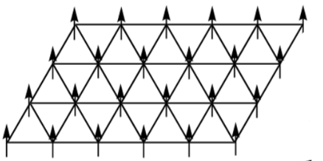
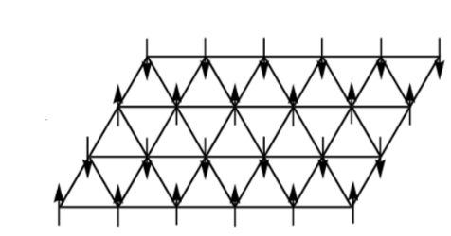
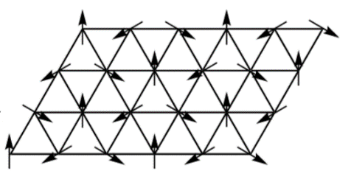
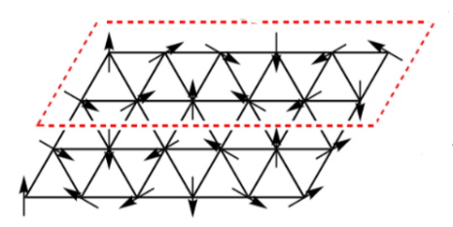
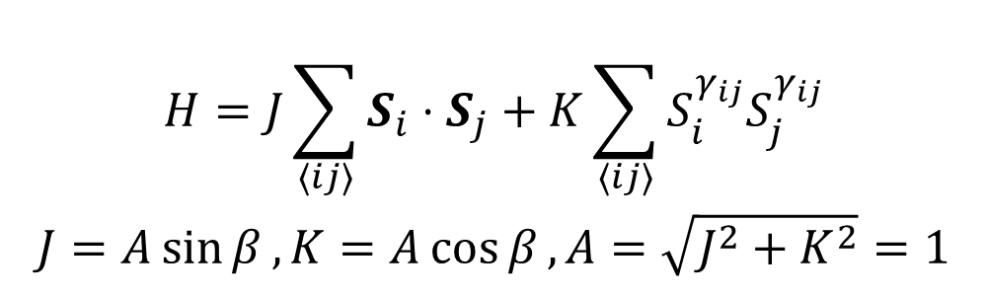
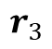
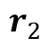
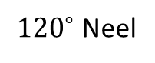
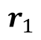
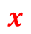
Kitaev Heisenberg model on triangular lattice
$$H=J\sum_{⟨ij⟩}{S_{i}⋅S_{j}}+K\sum_{⟨ij⟩}{S_{i}^{γ_{ij}}S_{j}^{γ_{ij}}}$$
$$J=A\sin{β},K=A\cos{β}, A=\sqrt{J^{2}+K^{2}}=1$$
$$r_{2}$$
y
$$r_{1}$$
z
$$x$$
$$r_{3}$$
FM
Stripe
${120}^{∘}$ Neel
Spiral
Kai Li, Shun-Li Yu and Jian-Xin Li, New J. Phys. 17, 043032 (2015)

Slide 7
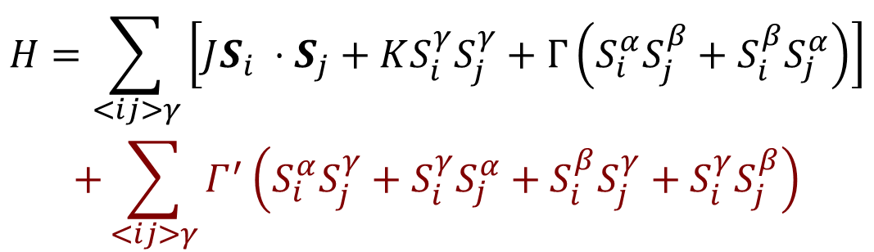
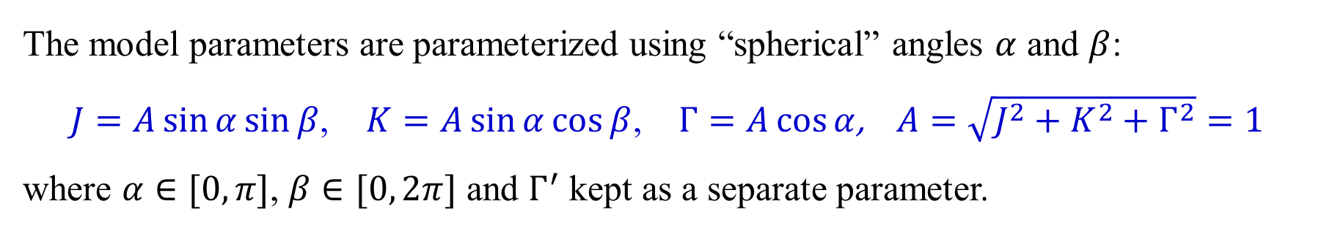
$J−K−Γ$ model on triangular lattice
$$H=\sum_{<ij>γ}{\left[JS_{i} ⋅S_{j}+KS_{i}^{γ}S_{j}^{γ}+Γ\left(S_{i}^{α}S_{j}^{β}+S_{i}^{β}S_{j}^{α}\right)\right]}$$
$$+\sum_{<ij>γ}{Γ^{′}\left(S_{i}^{α}S_{j}^{γ}+S_{i}^{γ}S_{j}^{α}+S_{i}^{β}S_{j}^{γ}+S_{i}^{γ}S_{j}^{β}\right)}$$
$$r_{2}$$
y
$$r_{1}$$
z
$$x$$
$$r_{3}$$
The model parameters are parameterized using “spherical” angles $α$ and $β$:
$J=A\sin{α}\sin{β}$, $K=A\sin{α}\cos{β}$, $Γ=A\cos{α}$, $A=\sqrt{J^{2}+K^{2}+Γ^{2}}=1$
where $α∈[0, π]$, $β∈[0, 2π]$ and $Γ^{′}$ kept as a separate parameter.

Slide 8
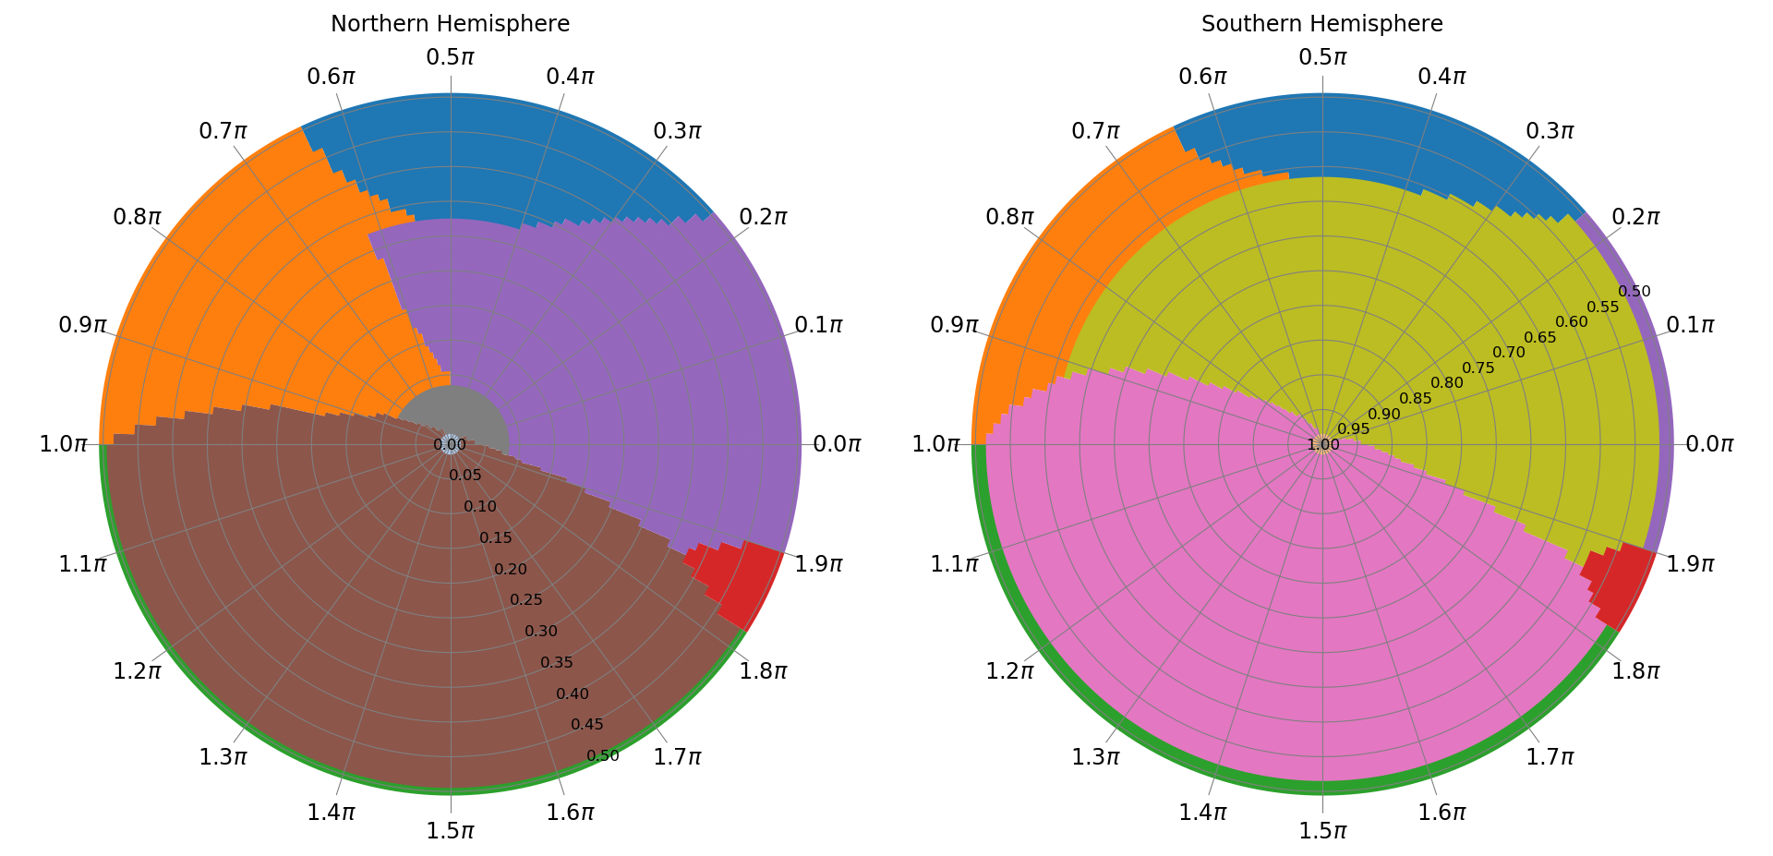
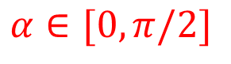
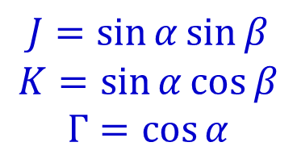
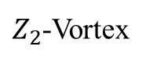
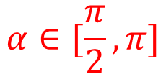
Global Phase Diagram
$$J=\sin{α}\sin{β}$$
$$K=\sin{α}\cos{β}$$
$$Γ=\cos{α}$$
$$α∈[\frac{π}{2},π]$$
$$α∈[0, π/2]$$
120度Neel序
Stripe沿着(111)方向整体旋转180度
Stripe
$Z_{2}$-Vortex
FM垂直于(111)方向的平面内
FM沿着(111)方向
Spiral
FM任意方向

Slide 9

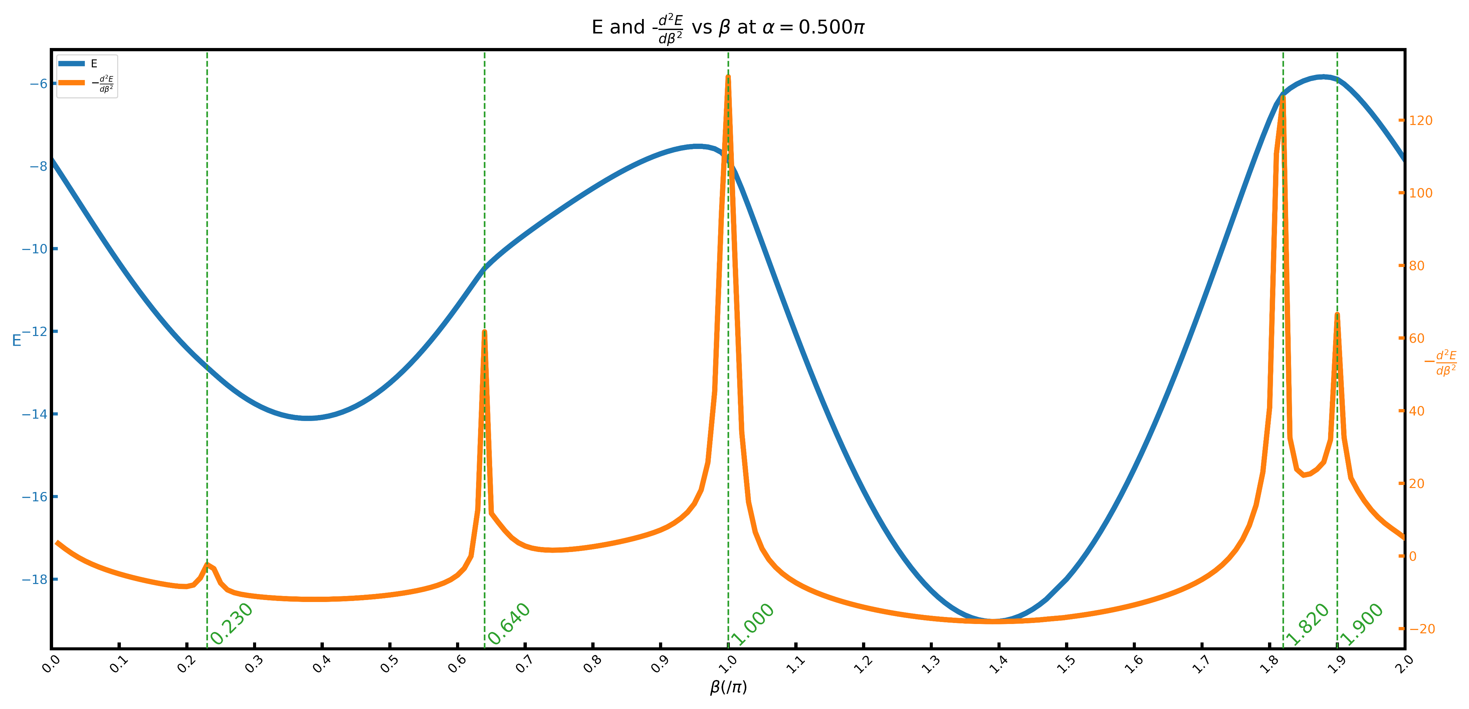
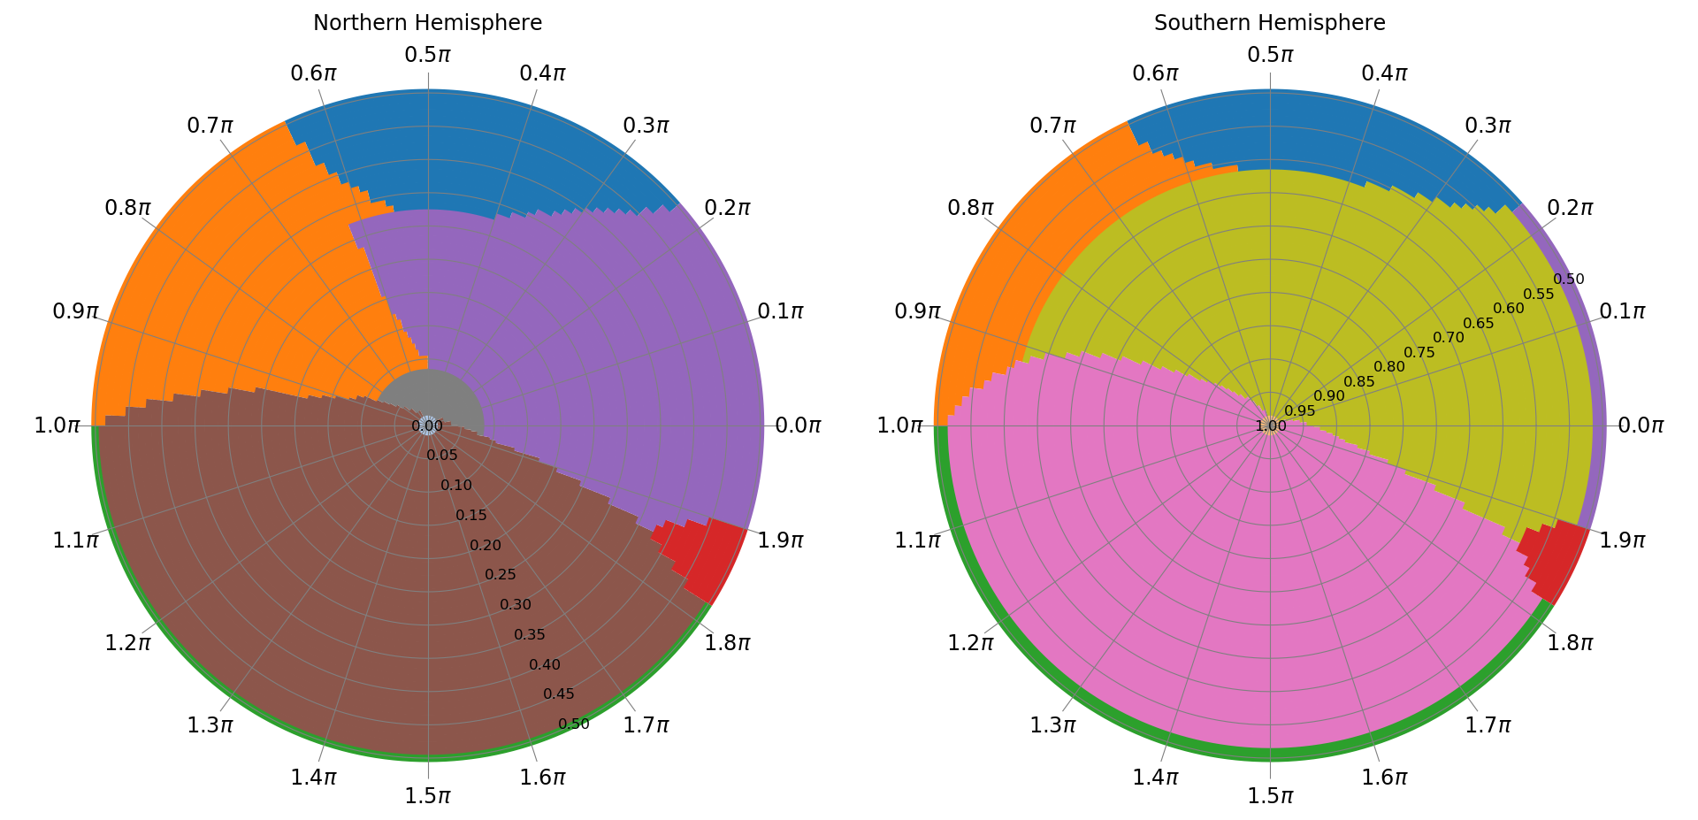
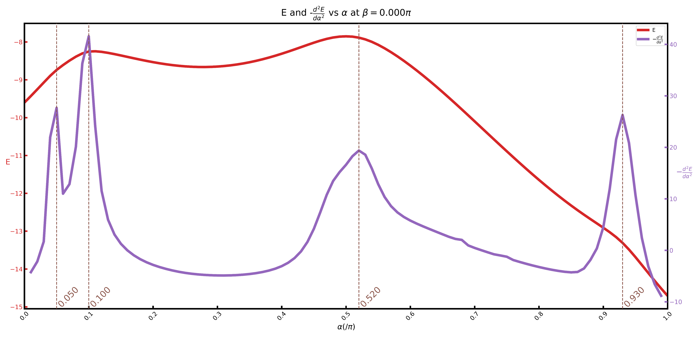
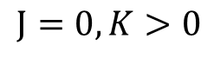
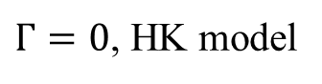
Phase boundary
$Γ=0$, HK model
$$J=0, K>0$$

Slide 10
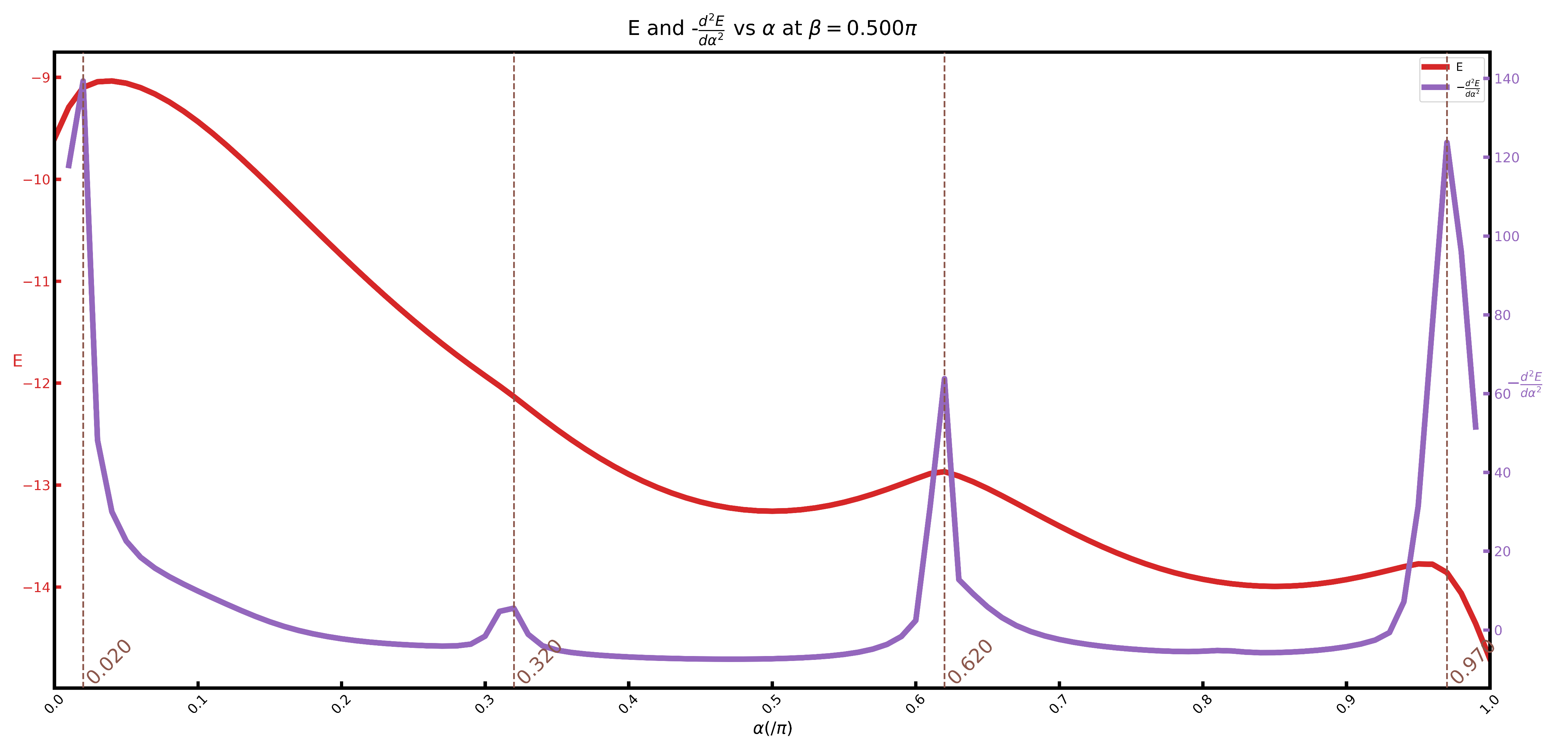
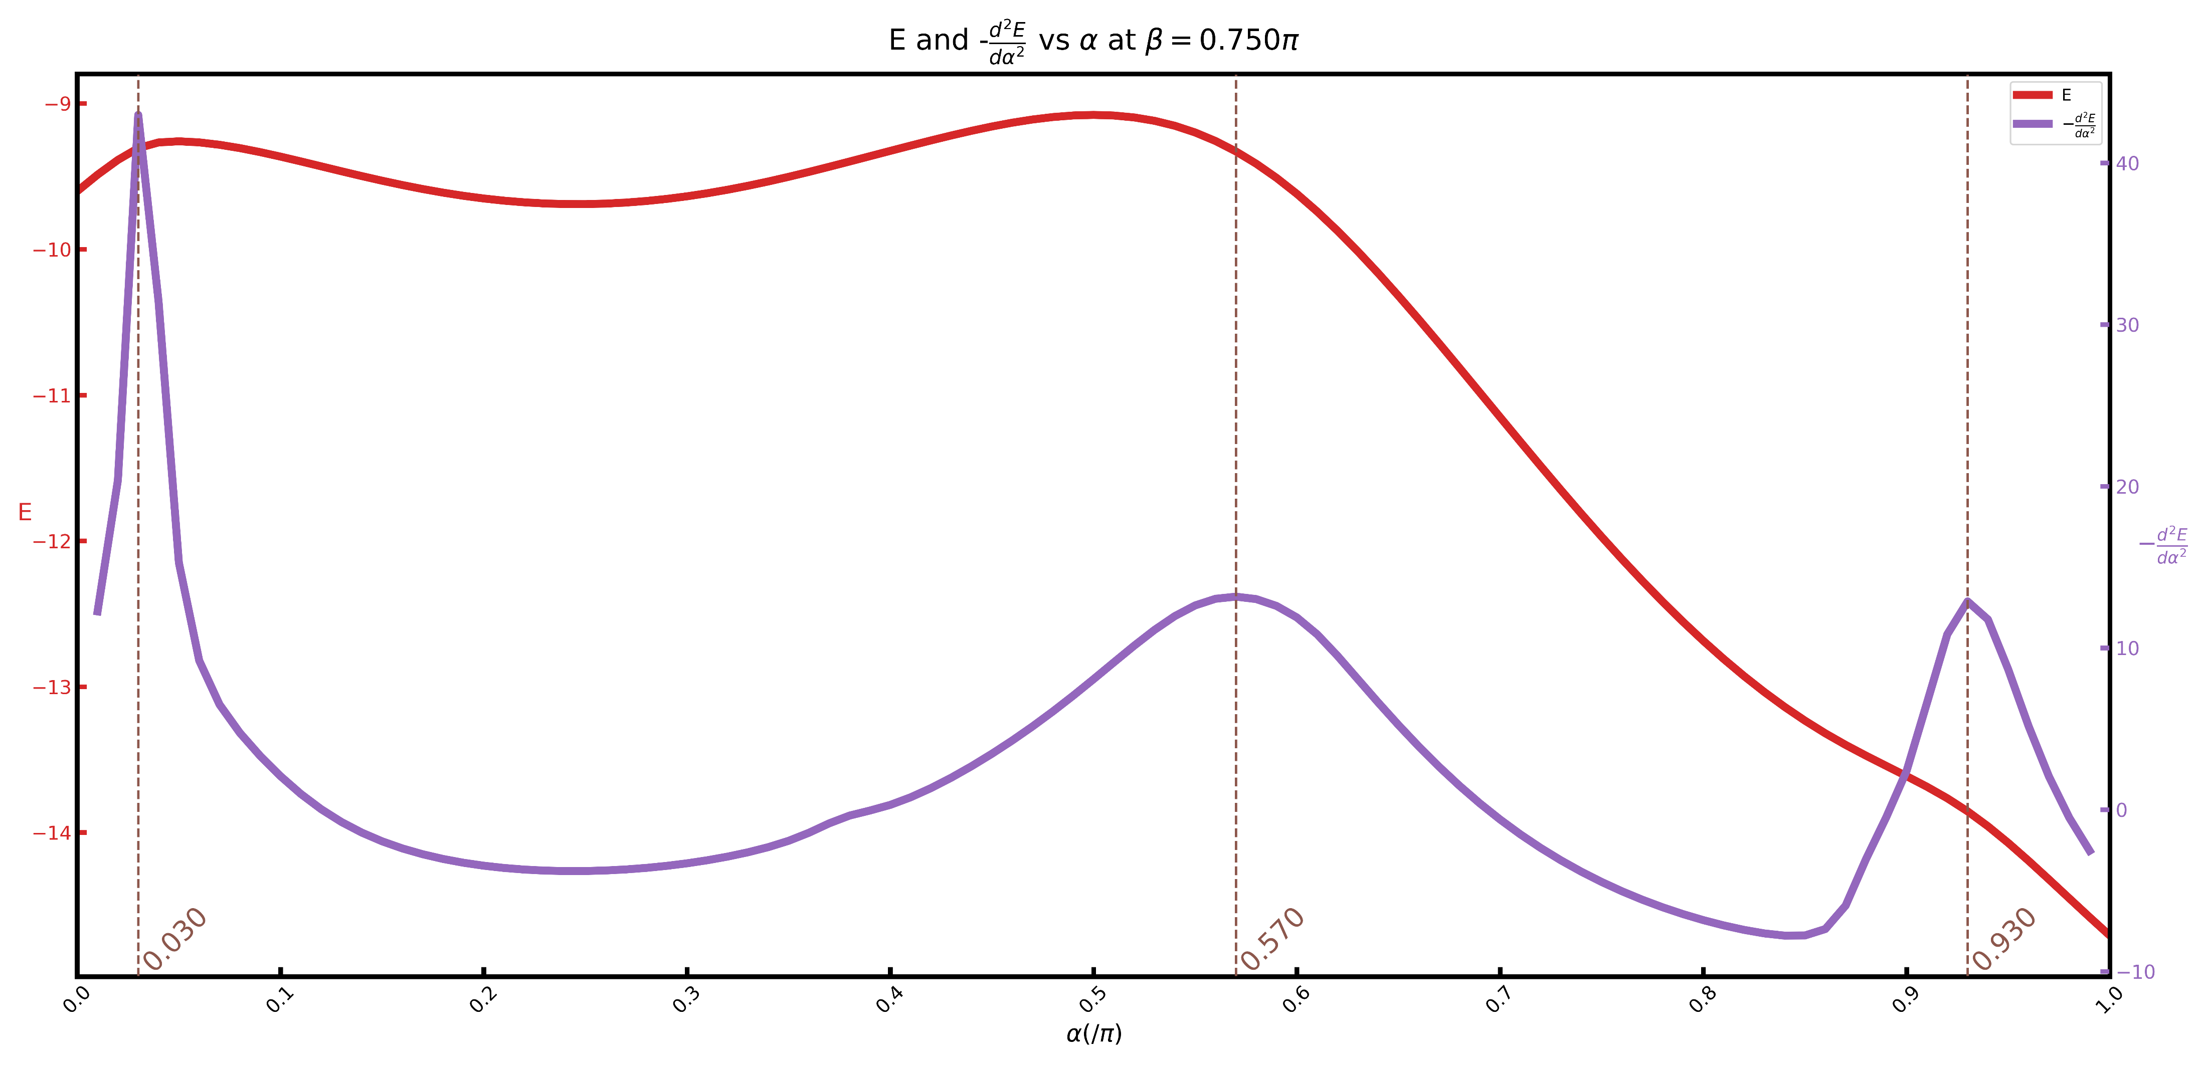
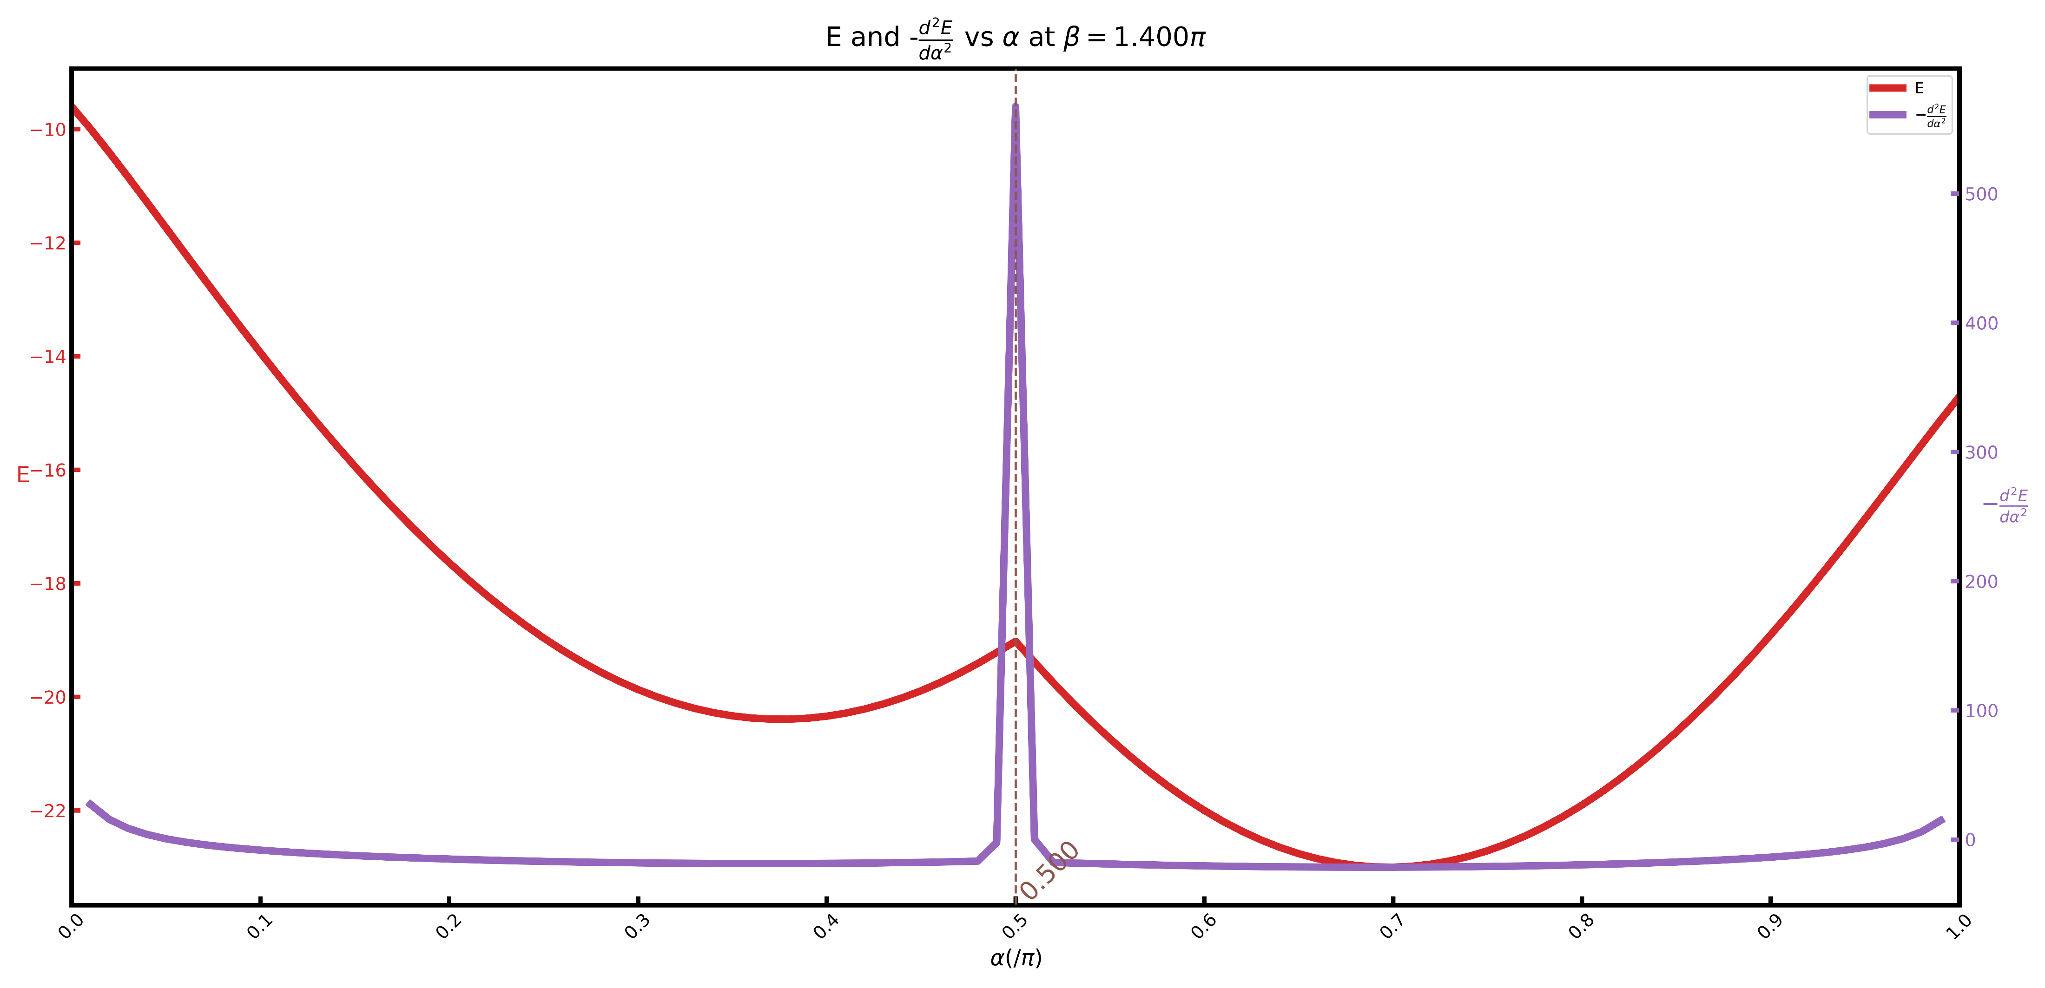
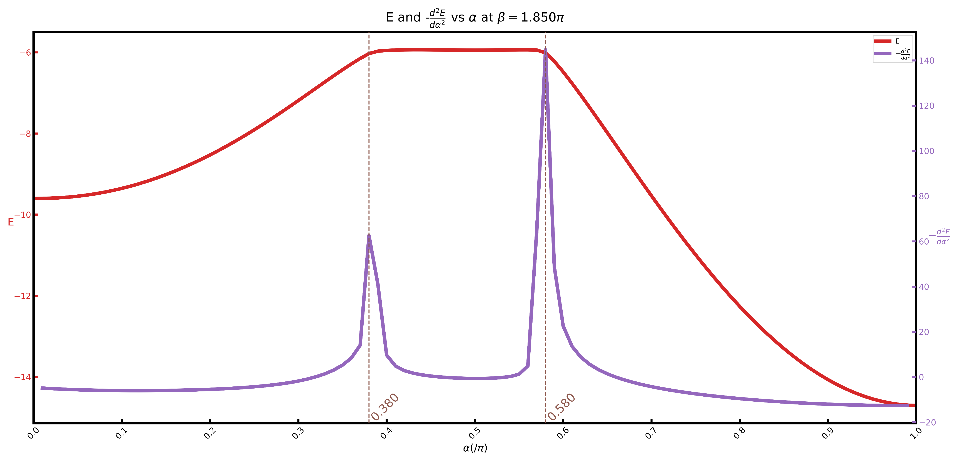
Phase boundary

Slide 11
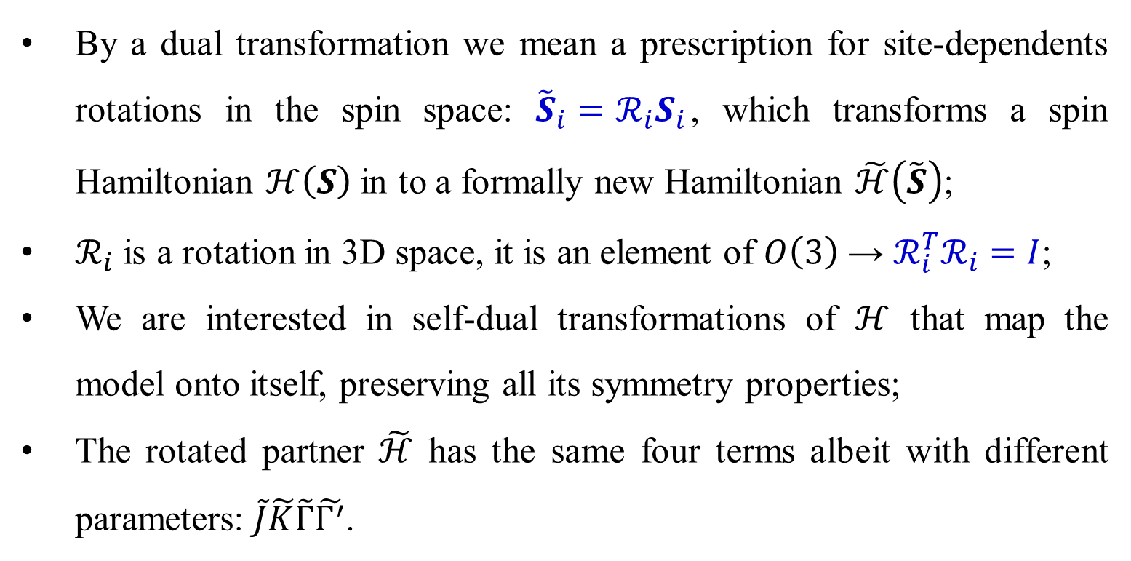
Dual Transformation
By a dual transformation we mean a prescription for site-dependents rotations in the spin space: ${\tilde{S}}_{i}=ℛ_{i}S_{i}$, which transforms a spin Hamiltonian $ℋ\left(S\right)$ in to a formally new Hamiltonian $\tilde{ℋ}\left(\tilde{S}\right)$;
$ℛ_{i}$ is a rotation in 3D space, it is an element of $O\left(3\right)$ → $ℛ_{i}^{T}ℛ_{i}=I$;
We are interested in self-dual transformations of $ℋ$ that map the model onto itself, preserving all its symmetry properties;
The rotated partner $\tilde{ℋ}$ has the same four terms albeit with different parameters: $\tilde{J}\tilde{K}\tilde{Γ}\tilde{Γ^{′}}$.
J. Chaloupka and G. Khaliullin, Phys. Rev. B 92, 024413 (2015)

Slide 12
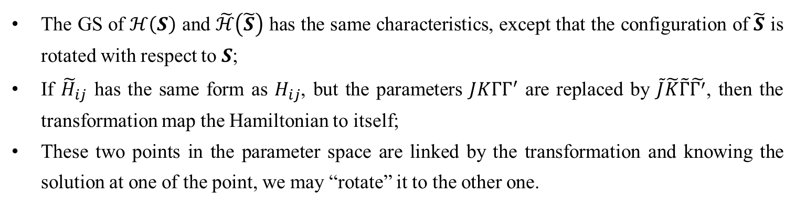
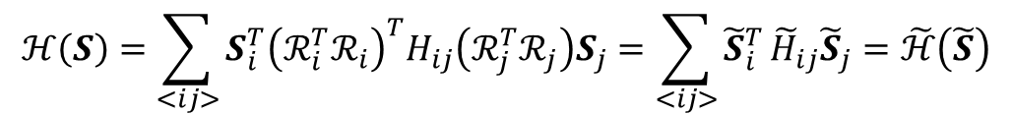
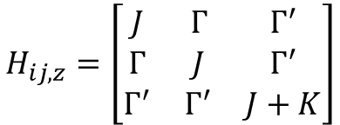
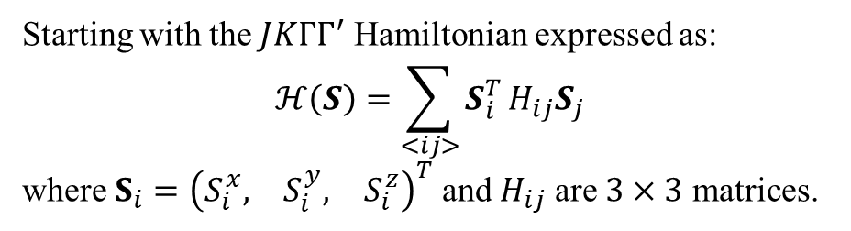
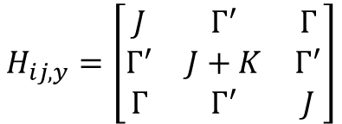
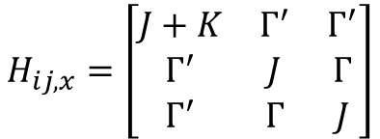
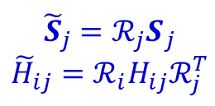
Dual Transformation
Starting with the $JKΓΓ^{′}$ Hamiltonian expressed as:
$$ℋ\left(S\right)=\sum_{<ij>}{S_{i}^{T}}H_{ij}S_{j}$$
where $S_{i}={\left(\begin{matrix}S_{i}^{x}, & S_{i}^{y}, & S_{i}^{z}\end{matrix}\right)}^{T}$ and $H_{ij}$ are $3×3$ matrices.
https://github.com/wangshiphys/DualTransformation.git
$$H_{ij,x}=\left[\begin{matrix}J+K & Γ^{′} & Γ^{′} \\ Γ^{′} & J & Γ \\ Γ^{′} & Γ & J\end{matrix}\right]$$
$$H_{ij,y}=\left[\begin{matrix}J & Γ^{′} & Γ \\ Γ^{′} & J+K & Γ^{′} \\ Γ & Γ^{′} & J\end{matrix}\right]$$
$$H_{ij,z}=\left[\begin{matrix}J & Γ & Γ^{′} \\ Γ & J & Γ^{′} \\ Γ^{′} & Γ^{′} & J+K\end{matrix}\right]$$
$$ℋ\left(S\right)=\sum_{<ij>}{S_{i}^{T}{\left(ℛ_{i}^{T}ℛ_{i}\right)}^{T}H_{ij}\left(ℛ_{j}^{T}ℛ_{j}\right)S_{j}}=\sum_{<ij>}{{\tilde{S}}_{i}^{T}}{\tilde{H}}_{ij}{\tilde{S}}_{j}=\tilde{ℋ}\left(\tilde{S}\right)$$
$${\tilde{S}}_{j}={ℛ_{j}S}_{j}$$
$${\tilde{H}}_{ij}=ℛ_{i}H_{ij}ℛ_{j}^{T}$$
The GS of $ℋ\left(S\right)$ and $\tilde{ℋ}\left(\tilde{S}\right)$ has the same characteristics, except that the configuration of $\tilde{S}$ is rotated with respect to $S$;
If ${\tilde{H}}_{ij}$ has the same form as $H_{ij}$, but the parameters $JKΓΓ^{′}$ are replaced by $\tilde{J}\tilde{K}\tilde{Γ}\tilde{Γ^{′}}$, then the transformation map the Hamiltonian to itself;
These two points in the parameter space are linked by the transformation and knowing the solution at one of the point, we may “rotate” it to the other one.

Slide 13
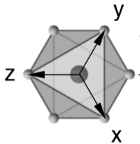
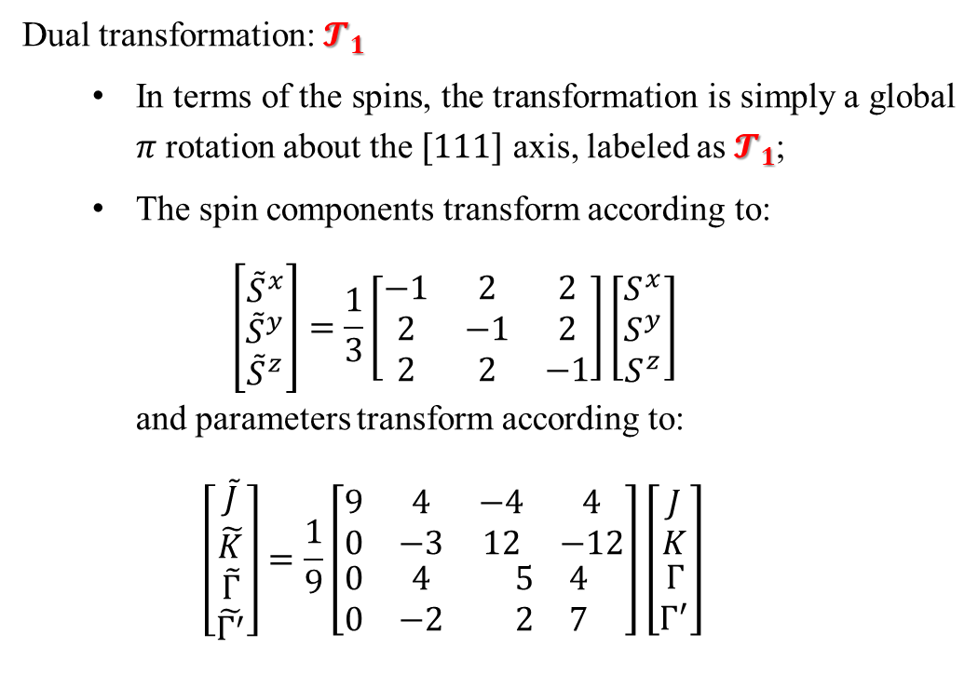

Dual Transformation
Dual transformation: $𝓣_{1}$
In terms of the spins, the transformation is simply a global $π$ rotation about the $[111]$ axis, labeled as $𝓣_{1}$;
The spin components transform according to:
$$\left[\begin{matrix}{\tilde{S}}^{x} \\ {\tilde{S}}^{y} \\ {\tilde{S}}^{z}\end{matrix}\right]=\frac{1}{3}\left[\begin{matrix}−1 & 2 & 2 \\ 2 & −1 & 2 \\ 2 & 2 & −1\end{matrix}\right]\left[\begin{matrix}S^{x} \\ S^{y} \\ S^{z}\end{matrix}\right]$$
and parameters transform according to:
$$\left[\begin{matrix}\begin{matrix}\tilde{J} \\ \tilde{K}\end{matrix} \\ \begin{matrix}\tilde{Γ} \\ \tilde{Γ^{′}}\end{matrix}\end{matrix}\right]=\frac{1}{9}\left[\begin{matrix}\begin{matrix}9 & 4 \\ 0 & −3\end{matrix} & \begin{matrix}−4 & 4 \\ 12 & −12\end{matrix} \\ \begin{matrix}0 & 4 \\ 0 & −2\end{matrix} & \begin{matrix}5 & 4 \\ 2 & 7\end{matrix}\end{matrix}\right]\left[\begin{matrix}\begin{matrix}J \\ K\end{matrix} \\ \begin{matrix}Γ \\ Γ^{′}\end{matrix}\end{matrix}\right]$$
Under this transformation, the model Hamiltonian become the following form:
$$\tilde{H}=\sum_{<ij>γ}{\left[\tilde{J}{\tilde{S}}_{i} ⋅{\tilde{S}}_{j}+\tilde{K}{\tilde{S}}_{i}^{γ}{\tilde{S}}_{j}^{γ}\right]}+\sum_{<ij>γ}{\left[\tilde{Γ}\left({\tilde{S}}_{i}^{α}{\tilde{S}}_{j}^{β}+{\tilde{S}}_{i}^{β}{\tilde{S}}_{j}^{α}\right)+{\tilde{Γ}}^{′}\left({\tilde{S}}_{i}^{γ}{\tilde{S}}_{j}^{α}+{\tilde{S}}_{i}^{α}{\tilde{S}}_{j}^{γ}+{\tilde{S}}_{i}^{γ}{\tilde{S}}_{j}^{β}+{\tilde{S}}_{i}^{β}{\tilde{S}}_{j}^{γ}\right)\right]}$$

Slide 14







Dual Transformation
Four-sublattice transformation: $𝓣_{4}$
$${\tilde{S}}_{0}=S_{0}$$
$${\tilde{S}}_{1}=(S_{1}^{x}, −S_{1}^{y}, −S_{1}^{z})$$
$$r_{2}$$
y
$$r_{1}$$
$${\tilde{S}}_{2}=({−S}_{2}^{x}, S_{2}^{y}, −S_{2}^{z})$$
z
$$x$$
$$r_{3}$$
$${\tilde{S}}_{3}=({−S}_{3}^{x}, {−S}_{3}^{y}, S_{3}^{z})$$
Under this transformation, the $J−K$ model can be mapped onto itself:
$\tilde{J}=−J$, $\tilde{K}=K+2J$
Combination transformation:$𝓣_{1}𝓣_{4}$
Under this transformation, the anisotropic $J−K−Γ−Γ^{′}$ model can be mapped back to a Heisenberg ferromagnet or antiferromagnet:
$\tilde{J}=−\frac{1}{9}J$, $\tilde{K}=−\frac{6}{9}J$, $\tilde{Γ}=\frac{8}{9}J$, $\tilde{Γ^{′}}=−\frac{4}{9}J$

Slide 15





$120°$ Neel Order
$J=\sin{α}\sin{β}$, $K=\sin{α}\cos{β}$, $Γ=\cos{α}$
$$J=1,K=0,Γ=0(α=0.5π,β=0.5π)$$
Antiferromagnetic Heisenberg model
(Blue area in the global phase diagram)
$$a_{0}$$
The ground state is $120°$ Neel order;
Magnetic unit-cell contains three lattice-sites as shown in Fig(1) and the translation vectors for magnetic unit-cell are:
$a_{0}=(\frac{3}{2},\frac{\sqrt{3}}{2})$, $a_{1}=(\frac{3}{2},−\frac{\sqrt{3}}{2})$
For $120°$ Neel order , the spin vectors are coplanar, and the angle between two adjacent spin vectors is $120°$;
The following figures show two representative spin configurations for the $120°$ Neel order.
$$a_{1}$$
Fig(1)

Slide 16


$120°$ Neel Order
Fig(2)
All spin vectors lying in the lattice plane
Fig(3)

Slide 17





Spiral Order
$J=\sin{α}\sin{β}$, $K=\sin{α}\cos{β}$, $Γ=\cos{α}$
$$J=−1,K=2,Γ=0(α=0.5π,β≈1.8524π)$$
The model Hamiltonian at this point can be mapped back to the antiferromagnetic Heisenberg model through $𝒯_{4}$ transformation.
(Red area in the global phase diagram)
Fig(1)
$$a_{0}$$
$$a_{1}$$
The ground state is the so called Spiral order;
Magnetic unit-cell contains 12 lattice-sites as shown in Fig(1) and the translation vectors for magnetic unit-cell are:
$a_{0}=(3,\sqrt{3})$, $a_{1}=(6,0)$

Slide 18



Spiral Order
One typical spin configuration of $120°$Neel order for antiferromagnetic Heisenberg model
Fig(2)
After $𝒯_{4}$ transformation, the $120°$Neel order shown in Fig(2) transformed to the following pattern Fig(3). The red dashed frame marks the magnetic unit-cell.
Fig(3)

Slide 19






FM Order
$J=\sin{α}\sin{β}$, $K=\sin{α}\cos{β}$, $Γ=\cos{α}$
$$J=−1,K=0,Γ=0(α=0.5π,β=1.5π)$$
Ferromagnetic Heisenberg model.
(Green area in the global phase diagram)
$$a_{1}$$
$$a_{0}$$
The ground state is FM order, all spins are parallel aligned;
The ground state energy $E_{0}=−3N/4$, where N is the number of lattice sites;
Magnetic unit-cell contains 1 lattice-site as shown in Fig(1) and the translation vectors for magnetic unit-cell are:
$a_{0}=(1,0)$, $a_{1}=(\frac{1}{2},\frac{\sqrt{3}}{2})$
Fig(1)
Fig(2)

Slide 20







Stripe Order
$J=\sin{α}\sin{β}$, $K=\sin{α}\cos{β}$, $Γ=\cos{α}$
$$J=1,K=−2,Γ=0(α=0.5π,β≈0.8524π)$$
The model Hamiltonian at this point can be mapped back to the ferromagnetic Heisenberg model through $𝒯_{4}$ transformation.
(Orange area in the global phase diagram)
$$a_{0}$$
$$a_{1}$$
The ground state is stripe order;
Magnetic unit-cell contains 4 lattice-sites as shown in Fig(1) and the translation vectors for magnetic unit-cell are:
$a_{0}=(1,\sqrt{3})$, $a_{1}=(2,0)$
Fig(1)

Slide 21


Rotated Spiral Order
$$J=−\frac{1}{9},K=−\frac{2}{3},Γ=\frac{8}{9},Γ^{′}=−\frac{4}{9}$$
The model Hamiltonian at this point can be mapped back to the antiferromagnetic Heisenberg model through$𝒯_{1}𝒯_{4}$ transformation.
Fig(1)
$$a_{0}$$
$$a_{1}$$
The ground state is called rotated spiral order;
Magnetic unit-cell contains 12 lattice-sites as shown in Fig(1) and the translation vectors for magnetic unit-cell are:
$a_{0}=(3,\sqrt{3})$, $a_{1}=(6,0)$

Slide 22




Rotated Spiral Order
$120°$ Neel Order
Spiral Order
Rotated Spiral Order

Slide 23


Rotated Stripe Order
$$J=\frac{1}{9},K=\frac{2}{3},Γ=−\frac{8}{9},Γ^{′}=\frac{4}{9}$$
The model Hamiltonian at this point can be mapped back to the ferromagnetic Heisenberg model through$𝒯_{1}𝒯_{4}$ transformation.
$$a_{0}$$
$$a_{1}$$
The ground state is rotated stripe order;
Magnetic unit-cell contains 4 lattice-sites as shown in Fig(1) and the translation vectors for magnetic unit-cell are:
$a_{0}=(1,\sqrt{3})$, $a_{1}=(2,0)$
Fig(1)

Slide 24



Rotated Stripe Order
FM Order
Stripe Order
Rotated Stripe Order

Slide 25



From $Γ^{′}≠0$ to $Γ^{′}=0$
$$H=\sum_{<ij>γ}{\left[JS_{i} ⋅S_{j}+KS_{i}^{γ}S_{j}^{γ}+Γ\left(S_{i}^{α}S_{j}^{β}+S_{i}^{β}S_{j}^{α}\right)\right]}$$
Implications from $𝒯_{1}𝒯_{4}$ transformation:
$\tilde{J}=−\frac{1}{9}J$, $\tilde{K}=−\frac{6}{9}J$, $\tilde{Γ}=\frac{8}{9}J$, $\tilde{Γ^{′}}=−\frac{4}{9}J$
For $J=1$, the corresponding $α,β$ is:
$α=0.207π,β=1.053π$ (A-point in the phase diagram)
For $J=−1$, the corresponding $α,β$ is:
$α=0.793π,β=0.053π$ (B-point in the phase diagram)
$$H_{Γ^{′}}=\sum_{<ij>γ}{Γ^{′}\left(S_{i}^{γ}S_{j}^{α}+S_{i}^{α}S_{j}^{γ}+S_{i}^{γ}S_{j}^{β}+S_{i}^{β}S_{j}^{γ}\right)}$$
B
A

Slide 26




From $Γ^{′}≠0$ to $Γ^{′}=0$
Ground state energy from A point to the Hidden SU(2) point which can be mapped back to Ferromagnet Heisenberg model by $𝒯_{1}𝒯_{4}$ transformation; The sharp peak at $Γ^{′}$ indicates a phase transition.
?
Rotated Spiral Order
Ground state energy from B point to the Hidden SU(2) point which can be mapped back to antiferromagnet Heisenberg model by $𝒯_{1}𝒯_{4}$ transformation; There is no phase transition between the two points. So the phase at B-point is of stripe-order with a global rotation along the (111) axis about 180 degree.
Rotated Stripe Order
Rotated Stripe Order

Slide 27

Classical Analysis
Spin operators are viewed as unit-vectors in 3D, ${\left(S^{x}\right)}^{2}+{\left(S^{y}\right)}^{2}+{\left(S^{z}\right)}^{2}$=1;
For general model parameters J, K and $Γ$, we first consider the state that all spin vectors are parallel aligned(FM state);
The energy of the $J−K−Γ$ model Hamiltonian at FM state:
$$E_{FM}=N\left(3J+K\right)\left[{\left(S^{x}\right)}^{2}+{\left(S^{y}\right)}^{2}+{\left(S^{z}\right)}^{2}\right]+2NΓ(S^{x}S^{y}+S^{x}S^{z}+S^{y}S^{z})$$
$$E_{FM}=\left(3J+K\right)N+2NΓ(S^{x}S^{y}+S^{x}S^{z}+S^{y}S^{z})$$
where N is the number of lattice sites. When $Γ≠0$, the energy of FM state is determined by the orientation of the spin vectors;
The problem now become finding the maximum and minimum value of the multi-variable function $f\left(S^{x},S^{y},S^{z}\right)=S^{x}S^{y}+S^{x}S^{z}+S^{y}S^{z}$ with the constraint: ${\left(S^{x}\right)}^{2}+{\left(S^{y}\right)}^{2}+{\left(S^{z}\right)}^{2}=1$;
$f\left(S^{x},S^{y},S^{z}\right)$ takes maximum value $f_{max}=1$ at $S^{x}=S^{y}=S^{z}={±1}/{\sqrt{3}}$;
$f\left(S^{x},S^{y},S^{z}\right)$ takes minimum value $f_{min}=−0.5$ when the condition $S^{x}+S^{y}+S^{z}=0$ and ${\left(S^{x}\right)}^{2}+{\left(S^{y}\right)}^{2}+{\left(S^{z}\right)}^{2}=1$ fulfilled;

Slide 28


Classical Analysis
According to previous analysis, the energy of the FM state is determined by the orientation of the spin vectors. To obtain lowest energy, the parallel aligned spin vectors must pointing to some specific direction. Addressed concretely:
For $Γ>0$, the spin vectors must lie in the plane specified by
$S^{x}+S^{y}+S^{z}=0$ and the corresponding energy is:
$$\frac{E_{FM}}{N}=\left(3J+K\right)−Γ$$
For $Γ=0$, the energy of the FM state has nothing
to do with the spin orientation:
$$\frac{E_{FM}}{N}=\left(3J+K\right)$$
For $Γ<0$, the spin vectors must along the positive or negative (111) direction and the corresponding energy:
$$\frac{E_{FM}}{N}=\left(3J+K\right)−2\left|Γ\right|$$

Slide 29



Classical Analysis
For small system size, the global minimum of the classical $J−K−Γ$ model can be found using global optimization algorithm.
$J=0,K=0,Γ=1(α=0, β=0)$
The spin vectors of FM state should lie in the plane perpendicular to the (111) direction and $\frac{E_{FM}}{N}=−1$;
We do find the FM state. We also find non-FM state which has the same energy as the FM state and the non-FM state does not have long-range order;
We do not find state whose energy is lower than the FM state.

Slide 30



Classical Analysis
$J=−0.5,K=−0.5,Γ={\sqrt{2}}/2(α=0.25π, β=1.25π)$(Brown area in global phase diagram)
The spin vectors of FM state should lie in the plane perpendicular to the (111) direction and the energy of the FM state: $\frac{E_{FM}}{N}=−\left(2+\frac{\sqrt{2}}{2}\right)=−2.707106$;
We only found this kind of FM state;
No state that is more energy favorable than the FM state is found;

Slide 31



Classical Analysis
$J=0,K=0,Γ=−1(α=π, β=0)$
The spin vectors of FM state should along the (111) direction and $\frac{E_{FM}}{N}=−2$;
We do find the FM state. We also find stripe state which has the same energy as the FM state;
We do not find any state that has lower energy than the FM state;

Slide 32



Classical Analysis
$J=−0.5,K=0.5,Γ=−{\sqrt{2}}/2(α=0.75π, β=1.75π)$(Pink area in the global phase diagram)
The spin vectors of FM state should along the (111) direction and $\frac{E_{FM}}{N}=−(1+\sqrt{2})$;
We only found this kind of FM state;
No state that is more energy favorable than the FM state is found.

Slide 33

Classical Monte Carlo
$$J=−0.279,K=0.960,Γ=0(α=0.5π, β=1.91π)$$

Slide 34


Classical Monte Carlo
$$α=0.001π, β=0.5π$$
$$J=0.003,K=0,Γ=0.9999$$

Slide 35

Summary
Using ED, dual-transformation and classical Monte Carlo, we map out the global phase diagram of the $J−K−Γ$ on triangular lattice;
We identify the mean-field level chiral spin liquid phase to be $Z_{2}$-Vortex;
We find an area in the global phase diagram which has no long range-order from classical point view, and speculate it to be a quantum spin liquid phase when quantum fluctuation is involved;
We will calculate the spin excitation spectrum to characterize all the phase in the global phase diagram:
$$G_{ij}^{r}\left(ω\right)=\left\langle Ω ∣ S_{i}^{−}\frac{1}{(ω+i0^{+})−H+E_{0}}S_{j}^{+} ∣ Ω\right\rangle +\left\langle Ω ∣ S_{i}^{+}\frac{1}{(ω+i0^{+})+H−E_{0}}S_{j}^{−} ∣ Ω\right\rangle$$

Slide 36
Thank you!

